Slide 1
Understanding Unified Family Court
The Honorable Ariana Fajardo Orshan
32nd Annual View from the
Family Bench Seminar
May 12, 2017

Slide 2
Question
Did you know that there is a Florida Family Law Rule of Procedure which provides that all related cases must be handled before one judge unless impractical?

Slide 3
Answer
Fla. Fam. L. R. P. 12.003 requires that all related family cases MUST be handled before one judge unless impractical.
See In re Amendments to the Florida Rules of Judicial Administration, 132 So. 3d 1114 (Fla. 2014)

Slide 4
What is impractical?

Slide 5
What is the Unified Family Court?
“One Family, One Judge” Model
Related cases handled by one judge
Less adversarial approach
Collaboration between judiciary and system partners
Promotes judicial economy, minimizes inconvenience to attorneys and litigants, prevents conflicting orders and duplication of resources
Therapeutic Jurisprudence

Slide 6
History of Unified Family Court
Year | Supreme Court Opinion | Highlights
2001 | In re Report of the Family Court Steering Committee, 794 So. 2d 518 (Fla. 2001) (“UFC I”) | Adoption of Family Court Steering Committee Recommendations: Family Court Principles Family Division Structure (one admin) & Jurisdiction Coordinated Management Model Trained Judges Family Court Staff Family Law Advisory Group (FLAG) Public Education Family Court Summit

Slide 7
History of Unified Family Court
Year | Supreme Court Opinion | Highlights
2014 | In re Amendments to the Florida Rules of Judicial Administration, 132 So. 3d 1114 (Fla. 2014) (“UFC II”) The FLSC reiterated the 2001 opinion and advised circuits this was mandatory, not optional. | SC 12-2007 - Steering Committee proposed amendments to Florida Rule of Judicial Administration 2.545(d) (Case Management; Related Cases) SC 12-2030 - Steering Committee proposed (5) new Florida Family Law Rules of Procedure (“Rule”)

Slide 8
History of Unified Family Court
Year | Supreme Court Opinion | Highlights
2014 | In re Amendments to the Florida Rules of Judicial Administration, 132 So. 3d 1114 (Fla. 2014) (“UFC II”) Now we have RULES! | Rule 12.003 (Coordination of Related Family Cases and Hearings) Rule 12.004 (Judicial Access and Review of Related Family Law Files) Rule 12.006 (Filing Copies of Orders in Related Family Cases) Rule 12.007 (Access and Review of Related Family Files by Parties) Rule 12.271 (Confidentiality of Related Family Hearings)

Slide 9
Case law – UFC principles
Perlow v. Berg Perlow, 975 So. 2d 383, 393 (Fla. 2004)
In the concurring opinion, Justice Pariente noted that the case served as a reminder of the importance of the principles for a unified family court: [O]ur goal continues to be the creation of “a fully integrated, comprehensive approach to handling all cases involving children and families,” while at the same time resolving family disputes in a fair, timely, efficient, and cost-effective manner. We also stress the importance of embracing methods of resolving disputes that do not cause additional emotional harm to the children and families who are required to interact with the judicial system. (citation omitted).

Slide 10
Therapeutic Jurisprudence
TJ is a process that may be applicable in certain cases to address the family’s interrelated legal and nonlegal problems. The concept is to produce a result that seeks to improve the family’s functioning and empower families, through skills development and a variety of alternative resolution forums, to resolve their own disputes thereby reducing emotional trauma.

Slide 11
Definition of a “Related Case” 11th Circuit’s UFC AO #16-02
A related case is defined as two or more cases pending in the Juvenile, Family, and/or Domestic Violence Divisions which involve any of the same parties, children, or issues.
Related cases involving the same family shall be handled before one judge in order that they shall be coordinated, heard and determined in a manner that will minimize the number of times and places that a family has to appear in court and will minimize the possibility of conflicting determinations of the same or Related Case.
[See AO #16-02(IV)(A)(1), 11th Judicial Circuit of Florida]

Slide 12
What is considered a “Family” Matter for purposes of a Unified Family Court?
Domestic Relations
Delinquency
Dependency
Domestic Violence

Slide 13
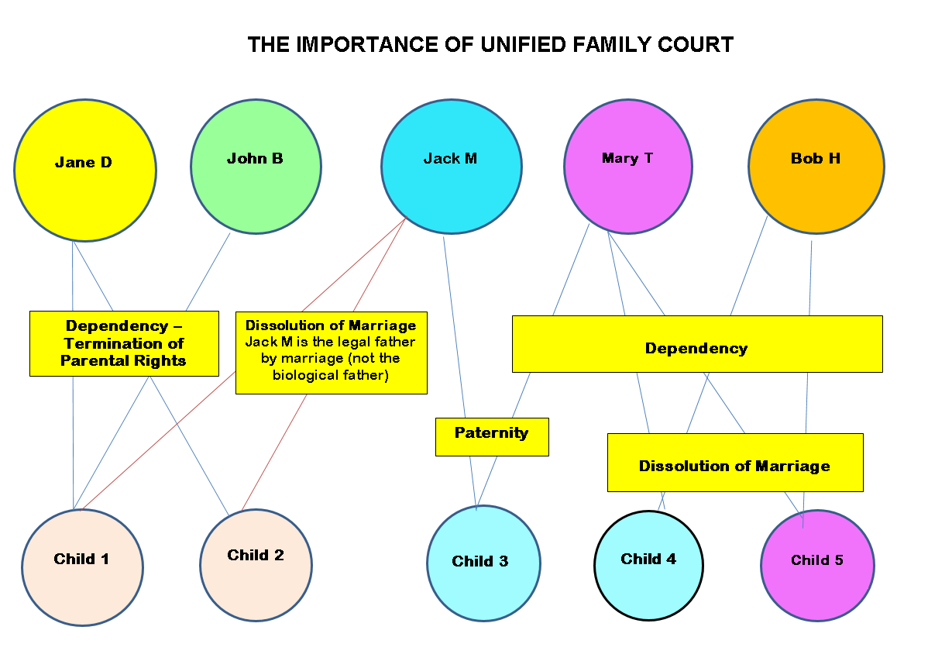

Slide 14
Define a “Family” - Example 1

Slide 15
“Family” - Example 2

Slide 16
Some Issues Affecting the Implementation of the UFC Model
Different practices among circuits
Availability of resources
Technology linking related cases
Complexity of cases/time requirements
Need for more judges
Forum shopping

Slide 17
Unique Issues Affecting Unified Family Court
Guardian Ad Litem | Chapter 39 vs. Chapter 61 Proceeding
Appearance of Children in Court | Fla. R. Juv. P. 8.100 vs. Fla. Fam. L. R. P. 12.407
Attorneys’ Fees | Chapter 61, Fla. Stat. Chapter 39, Fla. Stat. Chapter 741, Fla. Stat.

Slide 18
Case law - GAL
O’Connor v. State, Dep’t of Health & Rehab. Servs., 680 So. 2d 1137 (Fla. 3d DCA 1996)
Third District Court of Appeal held that the statute governing authority of guardian ad litems in dissolution, modification, parental responsibility, custody, or visitation cases did not apply to action to terminate parental rights prosecuted by guardian ad litem.

Slide 19
Case law – One Family Division
C.S. v. I.V., 899 So. 2d 444 (Fla. 4th DCA 2005)
Instead of filing a Chapter 39 petition for termination of parental rights, the former husband filed an untimely notice of appeal. In this case, the appellate court noted: “This case provides a perfect example of the procedural quagmire faced by litigants in attempting to navigate the legal system within the independent divisions of the court. It is for this very reason that our supreme court has advocated the establishment of a Unified Family Court where one judge can resolve the various legal issues affecting one family.”

Slide 20
Case law – Prior Knowledge
Coe v. Coe, 39 So. 3d 542, 543 (Fla. 2d DCA 2010)
The appellate court held that a trial court could not base its decision to grant former wife a permanent injunction against domestic violence on observations it made during a three-day custody hearing in postdissolution of marriage proceedings. The trial court’s observations in the custody matter were not part of the record in the proceeding on wife’s petition for an injunction against domestic violence. Further, the trial court did not follow the procedure for taking judicial notice of records and proceedings in the custody matter.

Slide 21
Case law – Conflict in Orders
Department of Children and Families v. D.B.D., 42 So. 3d 916 (Fla. 4th DCA 2010)
The appellate court affirmed the family court judge’s decision to dismiss the dependency injunction based on section 39.504, Florida Statutes. In dissolving the injunction, the family court judge inquired why DCF sought an injunction under the statute when the mother had a remedy available to her in the pending family court case. In addition, the judge who entered the injunction was not apprised of the pending proceedings in family court.

Slide 22
Case law – Forum Shopping?
Wolfson v. Wolfson, 185 So. 3d 1273 (Fla. 3d DCA 2016)
The mother filed a private petition for dependency 12 days prior to a scheduled evidentiary hearing on modification issues after the appellate court denied her recusal of the family trial court judge. The filing of the dependency petition triggered the transfer of the case to the Unified Family Court Division and a new judge. While appellate court noted that the allegations in both pending petitions were the same, the court allowed the transfer given the matter would proceed to trial more quickly in Unified Family Court Division.

Slide 23
Possible Expansion of UFC
Guardianship proceedings (F.S. 744)
Marchman proceedings (F.S. 397)
General jurisdiction matters
Criminal DV cases

Slide 24
UFC – Are you ready?

