Slide 1
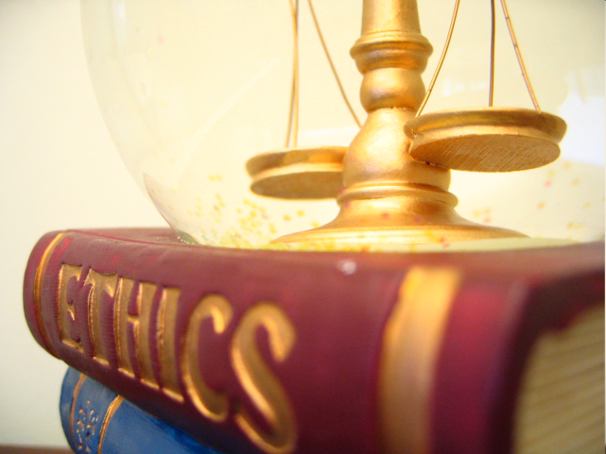
Nuts and Bolts of Ethics
Evan R. Marks, Esq.
Marks & West, P.A.

Slide 2
Extortion
836.05 Threats; extortion.—Whoever, either verbally or by a written or printed communication, maliciously threatens to accuse another of any crime or offense, or by such communication maliciously threatens an injury to the person, property or reputation of another, or maliciously threatens to expose another to disgrace, or to expose any secret affecting another, or to impute any deformity or lack of chastity to another, with intent thereby to extort money or any pecuniary advantage whatsoever, or with intent to compel the person so threatened, or any other person, to do any act or refrain from doing any act against his or her will, shall be guilty of a felony of the second degree, punishable as provided in s. 775.082, s. 775.083, or s. 775.084.
History.—s. 42, sub-ch. 3, ch. 1637, 1868; RS 2420; GS 3261; RGS 5092; CGL 7194; s. 1, ch. 57-254; s. 991, ch. 71-136; s. 1307, ch. 97-102.

Slide 3
Extortion and Confidentiality
Florida Statute §44.405(4)(a)(2) – Notwithstanding subsections (1) and (2), there is no confidentiality or privilege attached to a signed written agreement reached during a mediation, unless the parties agree otherwise, or for any mediation communication that is willfully used to plan a crime, commit or attempt to commit a crime, conceal ongoing criminal activity, or threaten violence.

Slide 4
How to Stay Out of Trouble
If it isn’t true, don’t say it
If it doesn’t feel right, don’t do it.
Return your phone messages, text messages, and your emails, the same day if possible.

Slide 5
QUESTIONS AND DISCUSSION

Slide 6
Good Luck and Stay Ethical!
Evan Marks, Esq.
Marks & West, P.A.
100 SE 2nd St., Suite 2700
Miami, Fl. 33131
Phone: 305-374-0210
emarks@marksandwest.com
Special thanks to my colleagues at Marks & West, P.A., and particularly my associate, Cyril Moody, for his assistance in the preparation of these materials.

