Slide 1
Hot Topics in PreNups and PostNups
The 28th Annual “Nuts & Bolts of Divorce”
Presented by: Dade Legal Aid-Put Something Back
Michelle M. Gervais, Esq.
Partner
Blank Rome LLP
December 4, 2020
Virtual Event

Slide 2
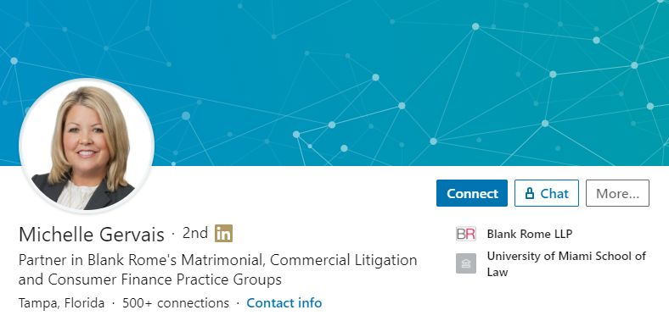
MGervais@BlankRome.com
813-255-2300
https://www.linkedin.com/in/gervaismichelle
Twitter: @MichGervais
Instagram: @michellemgervais

Slide 4
Florida Statute 61.079 – Premarital Agreements
Adopted in 2007 and is known as the Uniform Premarital Agreement Act.
Requires Premarital Agreement be in writing and signed by both parties.
Becomes effective upon the legal marriage of the parties.
Provides that after marriage, Premarital Agreement may only be amended, revoked or abandoned by a written agreement signed by both parties (unless the Agreement states otherwise).

Slide 5
Florida Statute 61.079 – Premarital Agreements - Cont’d
Explains the basis for which a Premarital Agreement is not enforceable (i.e. agreement not executed voluntarily; agreement was product of fraud, duress, coercion or overreaching; agreement was unconscionable when executed AND prior to execution, the complaining party: 1) was not provided a fair and reasonable disclosure of the assets and financial obligations of the other party; 2) did not voluntarily and expressly waive in writing any rights to disclosures of the other party beyond the disclosures provided; and 3) did not have or reasonably could not have had an adequate knowledge of the property or financial obligations of the other party.
Does not alter the construction, interpretation, or required formalities of, or the rights and obligations under, agreements between spouses pursuant to Fla. Stat. 732.701 and 732.702 (Probate Code – Succession and Waiver of Spousal Rights).

Slide 7
What Can be Waived in a Premarital Agreement?
Equitable Distribution; i.e. what otherwise may be considered marital assets and liabilities along with any increases in value thereof, appreciation and enhancement of non-marital assets;
Post-Dissolution Alimony (waiver must be specific and waiver to separate property, while not subject to equitable distribution, may still constitute income from which alimony obligations may be considered);
Modification of Alimony (waiver must be specific);
Elective Share; and
Post-Dissolution Attorney’s Fees, Suit Monies and Costs

Slide 8
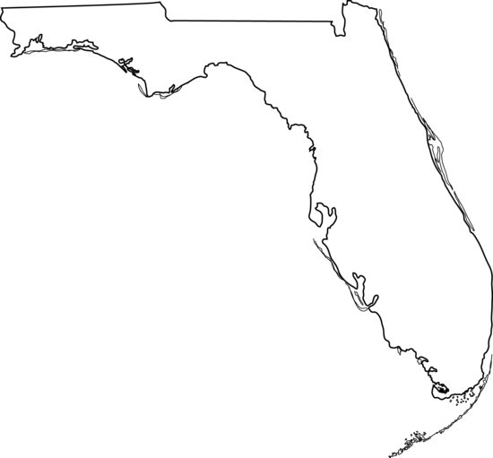
NOTARY
DISINTERESTED WITNESSES

Slide 9
What Cannot be Waived in a Premarital Agreement?
Temporary Support (Belcher v. Belcher, 271 So. 2d 7 (Fla. 1972) (finding against public policy in State of Florida to enforce waiver of temporary support). However, entitlement still required to be established by the court.
Temporary Attorney’s Fees: again against public policy in State of Florida and valid waiver provision in premarital agreement in another state will not be enforced in Florida. Entitlement still required to be established by the court. By way of contrast, however, prevailing party fee provisions in any action to enforce the premarital agreement will be upheld. See Lashkajani v. Lashkajani, 911 So. 2d 1154 (Fla. 2005).
Child Support, Access and Custody

Slide 10
How does the Probate Code affect Premarital Agreements?
Fla. Stat. 61.079 allows the parties to a premarital agreement to contract as to the making of a will.
Fla. Stat. 732.701 requires that any agreement to make a will (or not make a will) shall be binding or enforceable if it is in writing and signed in the presence of two attesting (and disinterested) witnesses.
Fla. Stat. 732.702 allows for a waiver of surviving spousal rights before marriage by written agreement, signed in writing in the presence of two attesting (and disinterested) witnesses. This includes waiver of homestead/elective share.
No consideration other than the execution of the premarital agreement is needed.

Slide 11
Premarital and Postmarital Agreement Quick Tips
Same principles that control the construction of other contracts apply to the interpretation of a premarital agreement.
Always insist the other party hire independent legal counsel (and have the party requesting the premarital agreement offer to reimburse the attorney’s fees and costs for that party’s counsel).
Require the parties enter into a Confidentiality Agreement prior to the disclosure of assets, income and obligations.
Time is of the essence – make sure the premarital agreement is presented to the other party well ahead of the wedding. Execution should take place at least one month prior to the date of the wedding. No signings on death bed.

Slide 12
Premarital Agreement Quick Tips – Cont’d
Make sure to have two disinterested witnesses and a notary present for the signing.
Full and frank disclosures of assets, income and obligations is very important and can result in a premarital agreement being overturned if not sufficiently disclosed.
Require individual Certifications of disclosures, independent and sufficient legal advice and signing of own free will by each party and by their respective attorneys. Still important to have consideration.
Have the execution of the premarital agreement be videotaped and/or at least take place before a court reporter and keep final product for safekeeping.

Slide 13
Attacking Premarital Agreements Casto v. Casto, 508 So. 2d 330 (Fla. 1987)
A premarital agreement may be set aside or modified upon establishing that it was reached under fraud, deceit, duress, coercion, misrepresentation, or overreaching.
The challenging spouse must establish that the premarital agreement makes an unfair or unreasonable provision for that spouse, given the circumstances of the parties. Once unfairness is established, a presumption arises that there was either concealment or a presumed lack of knowledge of the defending spouse’s finances at the time the premarital agreement was reached. The burden then shifts to the defending spouse. The presumption can be rebutted upon a showing that 1) the defending spouse made full, frank financial disclosures or 2) the challenging spouse had a general knowledge of the character and extent of the other party’s assets, income and obligations.

Slide 14
MGervais@BlankRome.com
813-255-2300
https://www.linkedin.com/in/gervaismichelle
Twitter: @MichGervais
Instagram: @michellemgervais

